Slide 1
Concerning environment: when I look around in the region where I live...
I sometimes see things that make me worrying for the future
I frequently see things that make me anxious for the future. Changes are necessary..
I see no problems concerning the environment that means a threat for the future

Slide 2
Percentage

Slide 3
Air pollution by factories

Slide 4
Air pollution

Slide 5
Garbage in rivers

Slide 6
What do you do to contribute to a more sustainable life, as for the energy that is used?
I bike or I use public transport
I take a shower instead of a bath
I try not to print too much
I do not do anything to contribute to a sustainable life
Other:
Walk; turn off light; recycle; save energy

Slide 7
Percentage

Slide 8
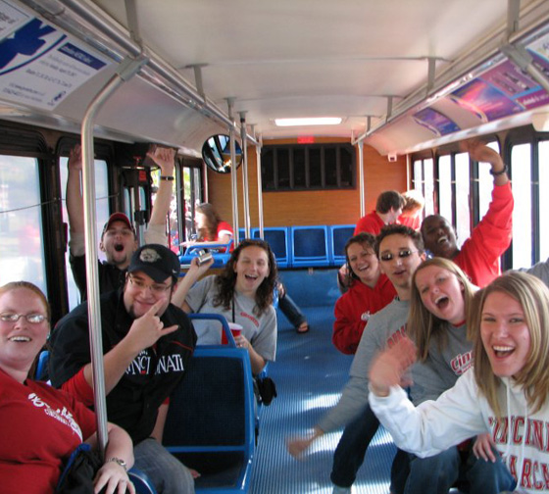
Take the bus instead of the car

Slide 9
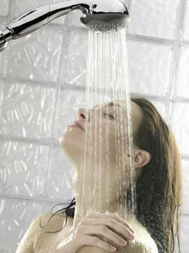
Take a shower instead of a bath

